Slide 1
塑料的发明为我们带来便利，然而，过去几十年里，塑料不断分解形成微塑料，并被生物摄入，从而进入食物链，并不断蓄积。 据统计，人平均每天摄入多少... 它会进一步导致腹胀、腹泻。已经有多少人受累。 幸运的是，我们是创造了一对超级菌搭档，名叫“XXXXXX”！ 它会被胶囊所包裹，以便于进入体内。 当您吞下胶囊后，我们将穿越消化系统的惊涛骇浪，一场精彩的冒险就开始了！ 在您的肠道里，我们会率先出击，寻找并分解那些潜伏的微塑料，把它们变得“面目全非”。 但同时，我们也会温柔地安抚肠道细胞，确保我们的清理工作不会打扰到主人的安宁。 我们的目标是：吃掉所有不该存在的塑料颗粒，还您一个干净、健康的肠道环境。 我们不仅是清洁工，更是您身体的贴身卫士。 选择“Plastosymbion”，就是选择为一个无塑的未来投票。 相信我们，让我们把地球和您的身体，从微塑料的困扰中解放出来！

Slide 2

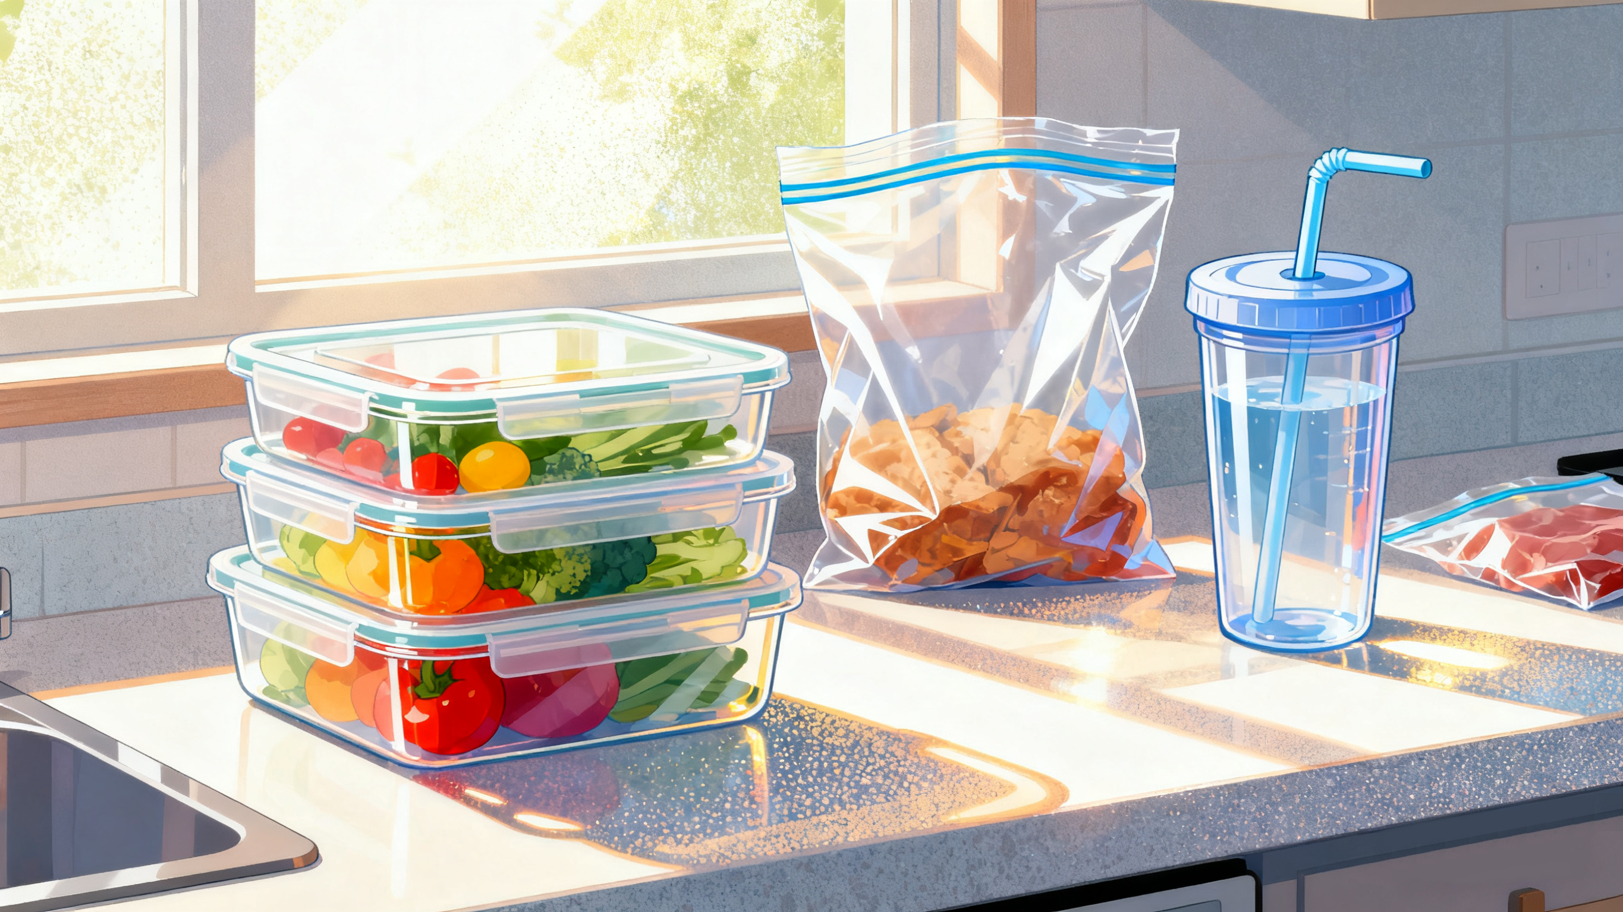
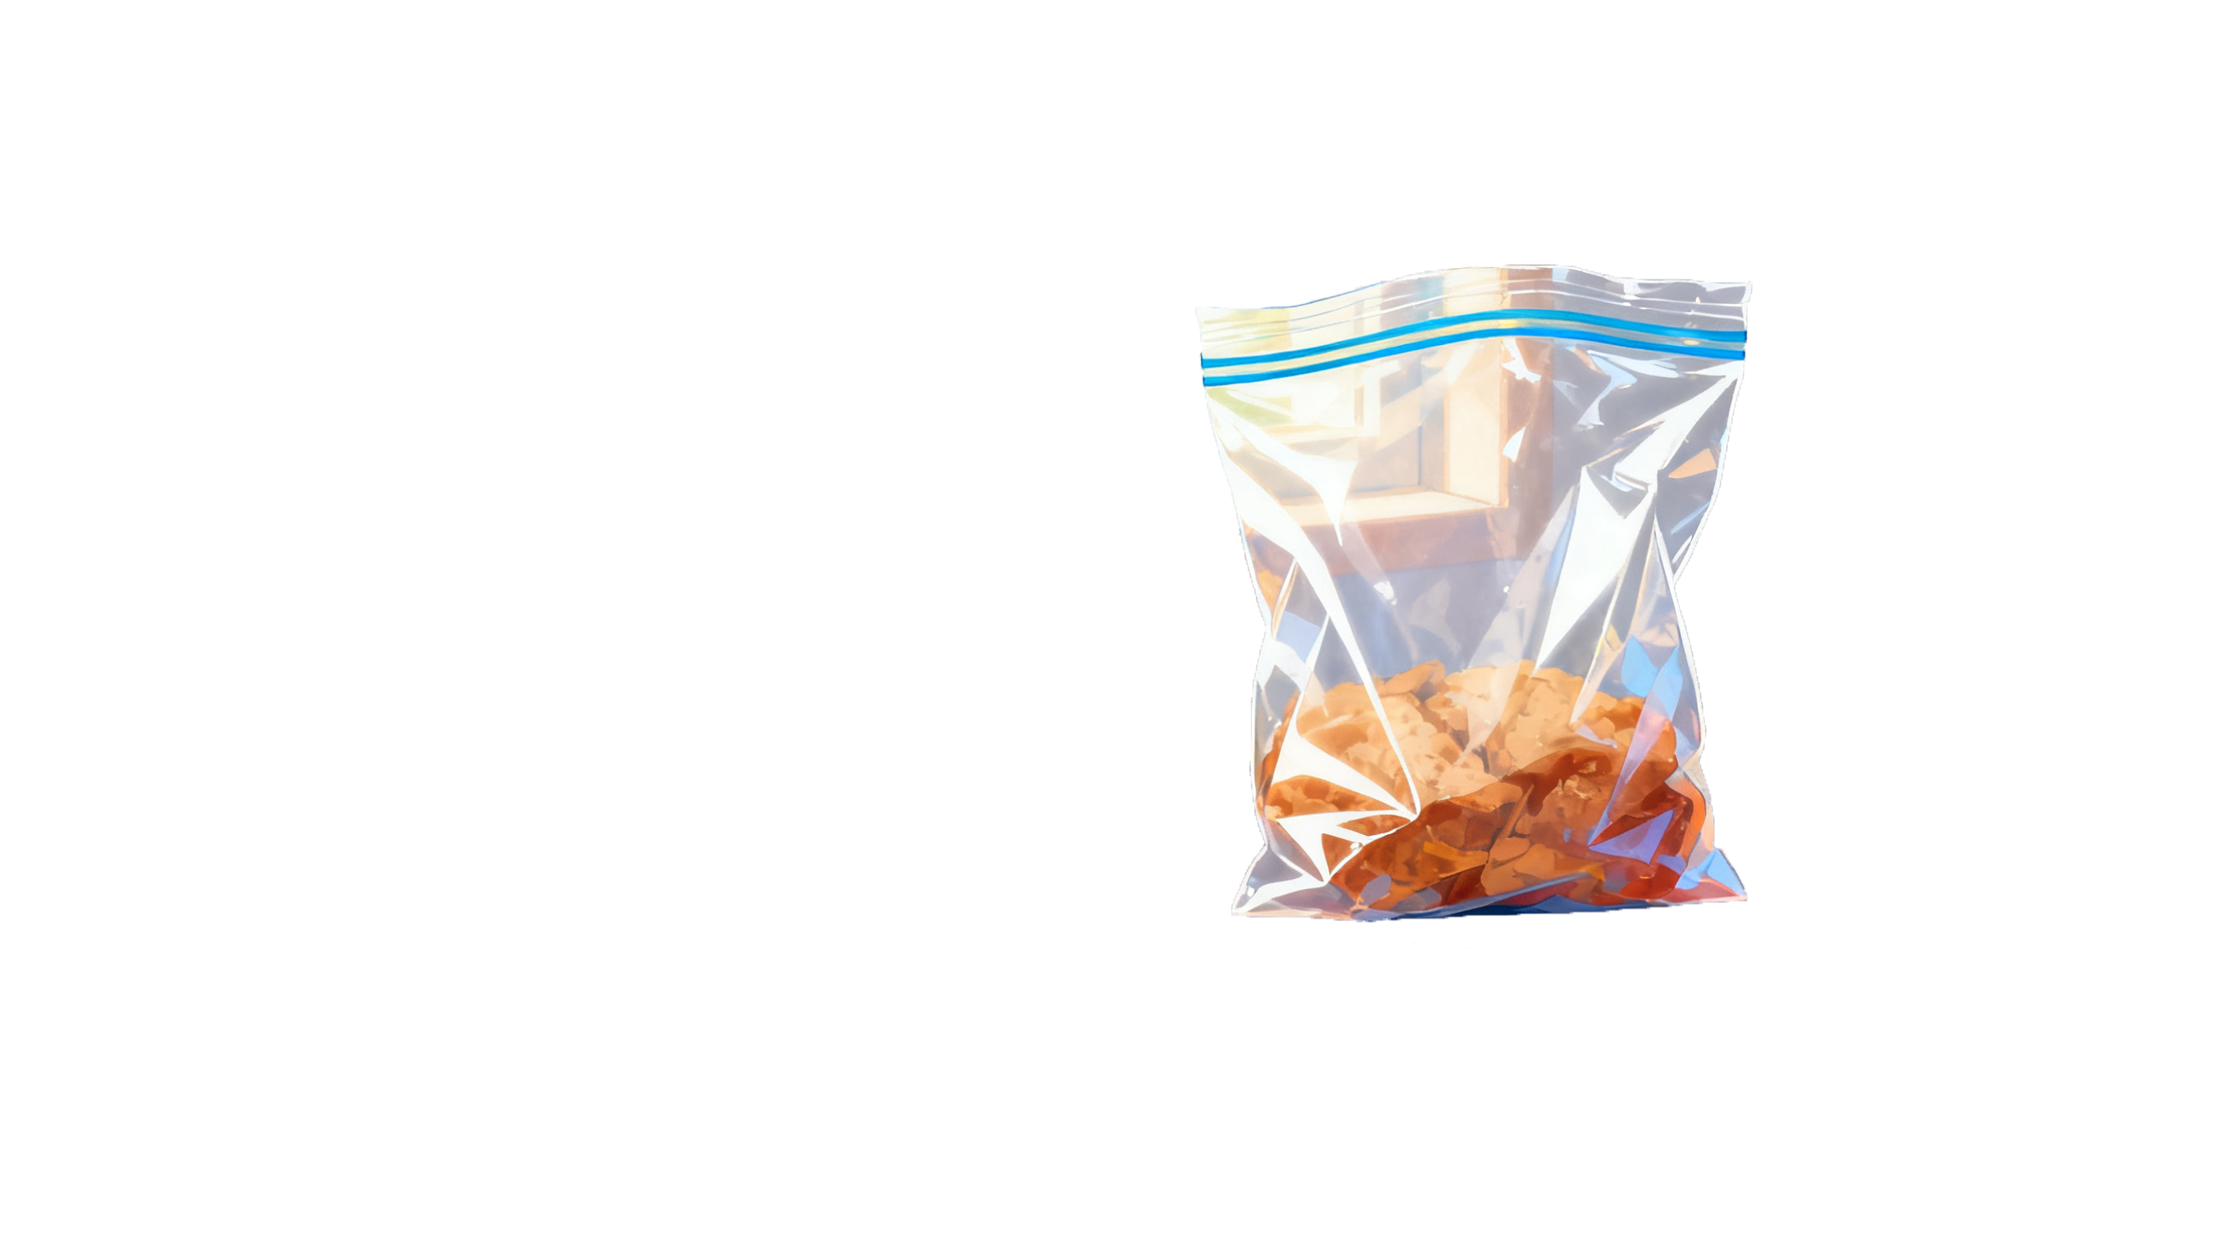
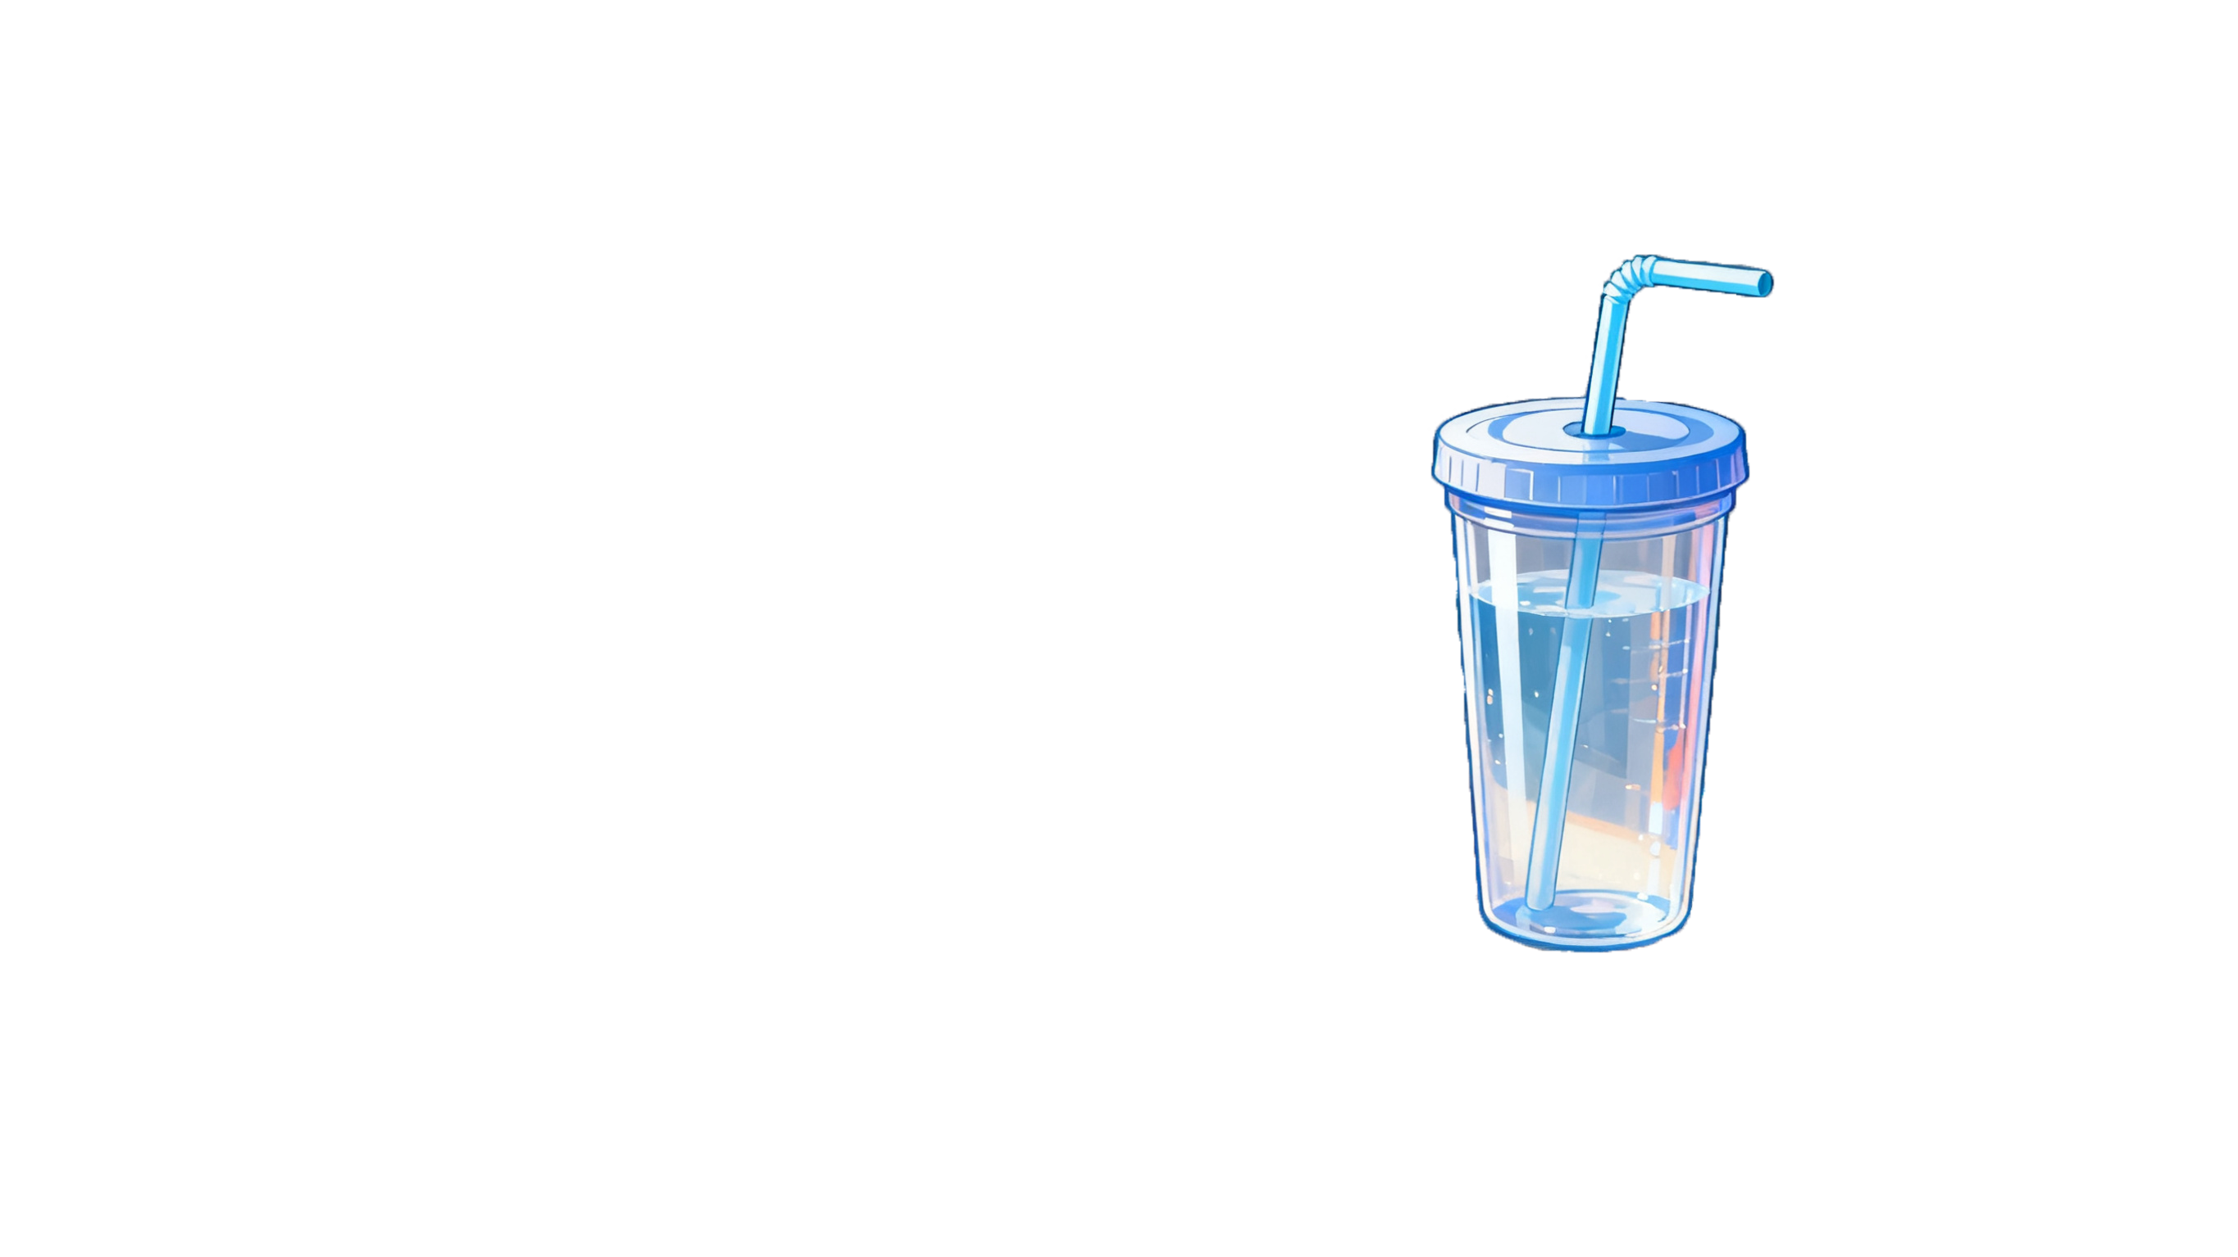
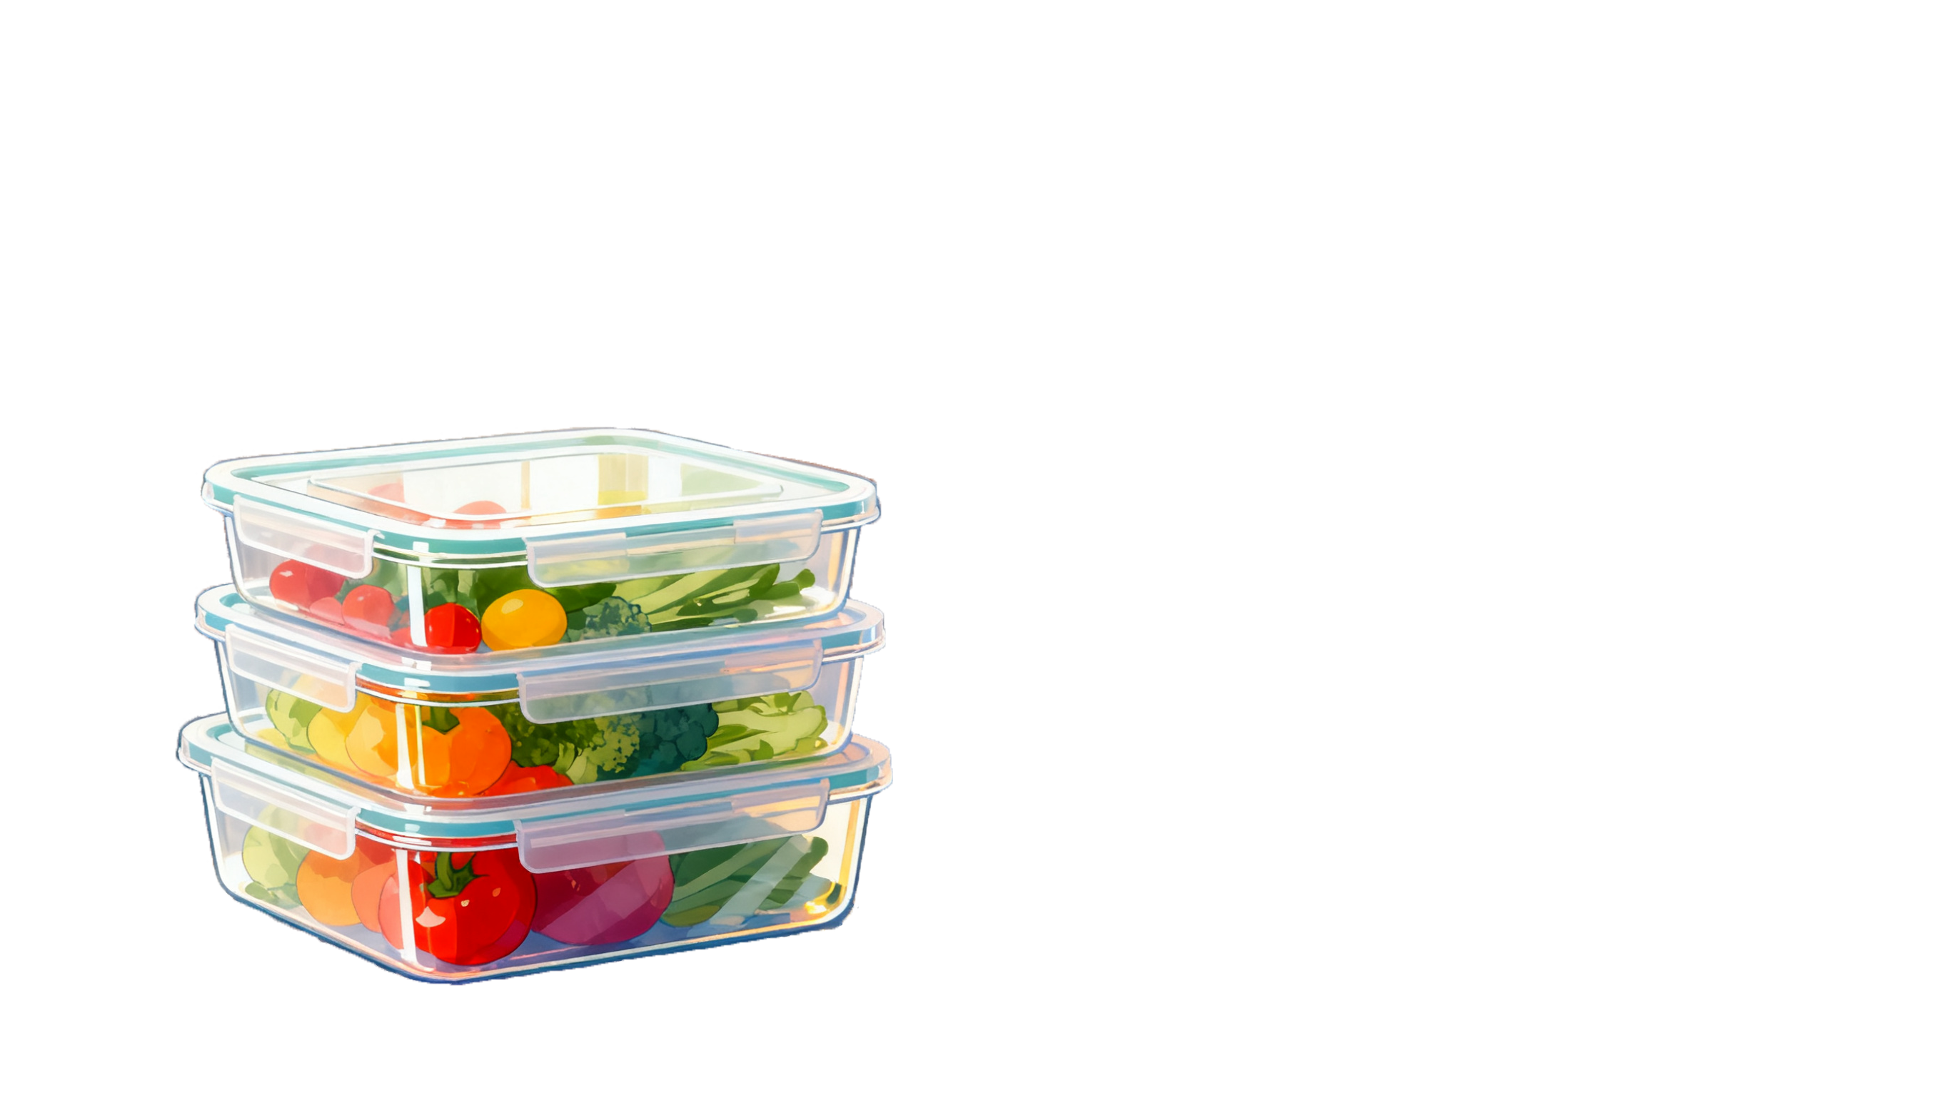
EnteroPlastivore
HOME
PROJECT
SAFETY
HUMAN PRACTICE
MODEL
TEAM
The invention of plastic has brought us great convenience.

Slide 3
EnteroPlastivore
HOME
PROJECT
SAFETY
HUMAN PRACTICE
MODEL
TEAM
Nowadays, it is everywhere.
*这个打算做一下漂浮的效果

Slide 4
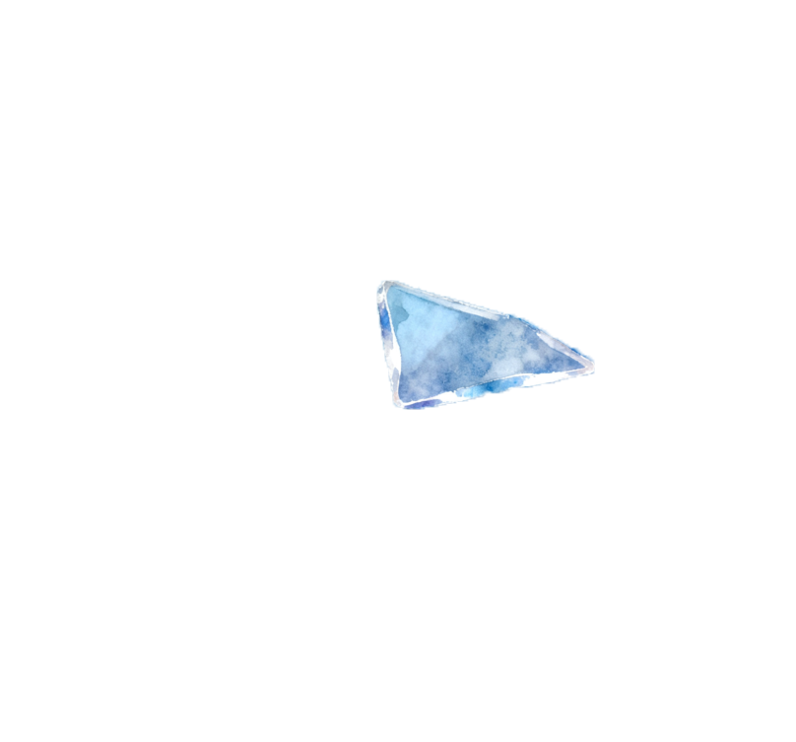
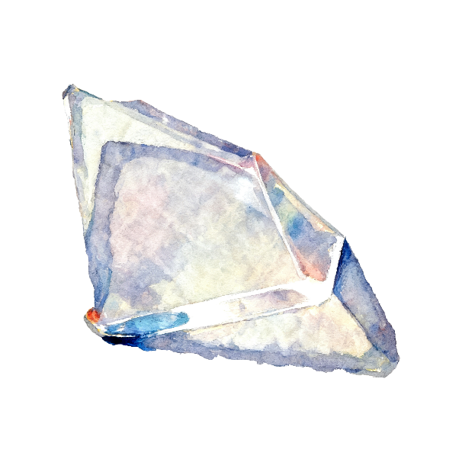
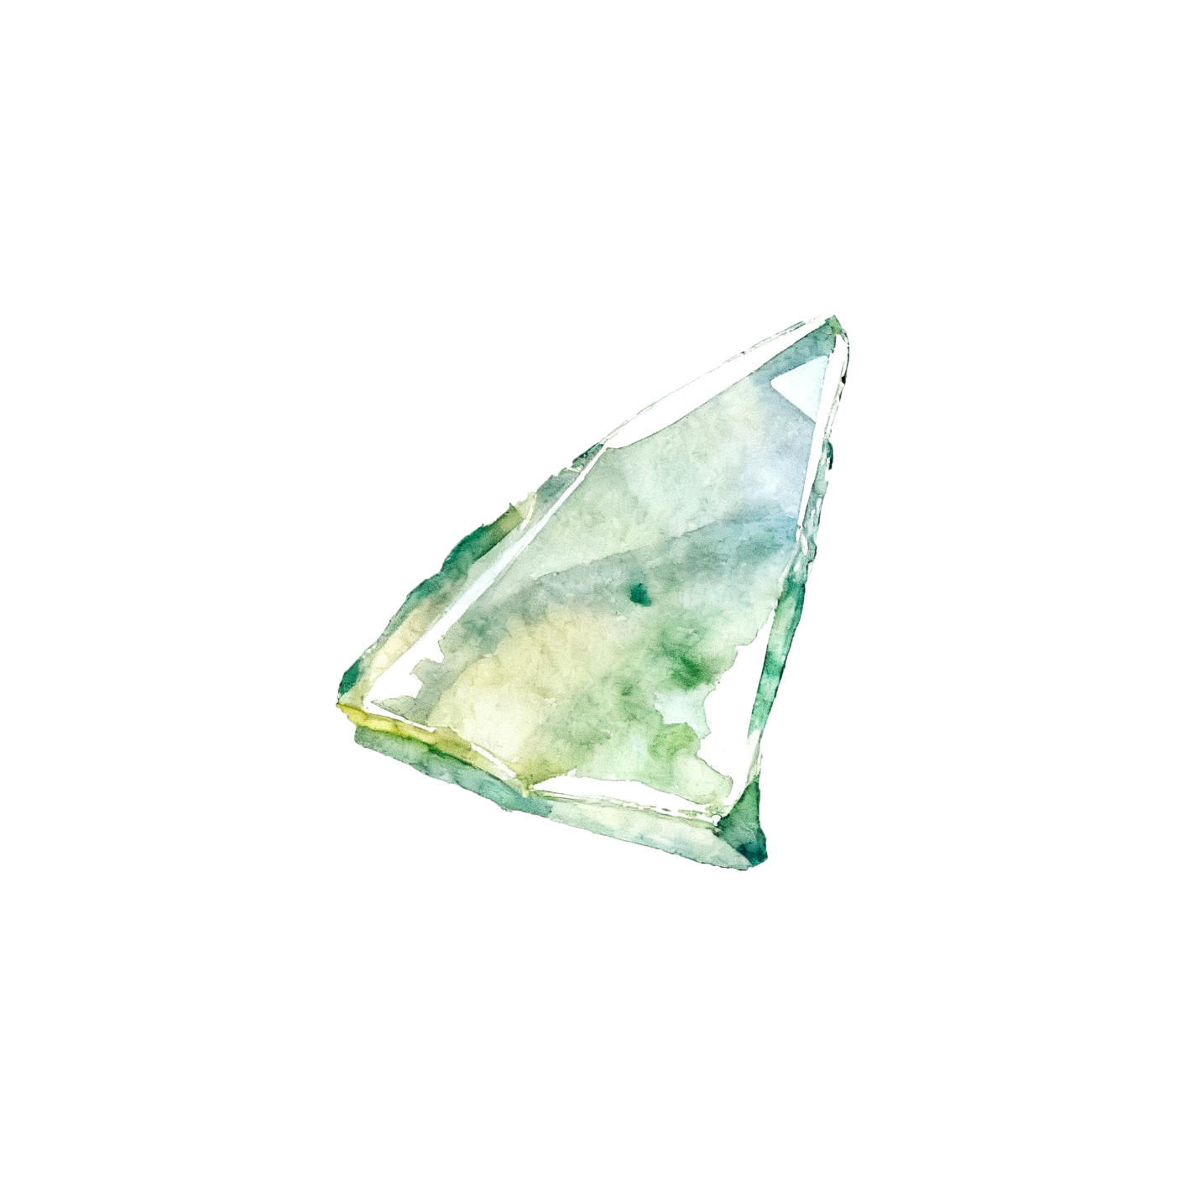
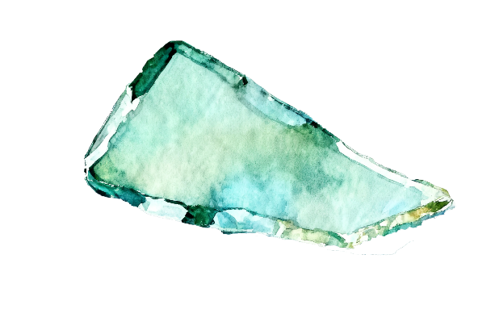
EnteroPlastivore
HOME
PROJECT
SAFETY
HUMAN PRACTICE
MODEL
TEAM
However, over the past few decades, plastic has been constantly breaking down into “microplastics”, which are ingested by living organisms.
Click me!
*这个打算做成漂浮的效果
*然后打算做个交互 点击后 会变成塑料碎片

Slide 5

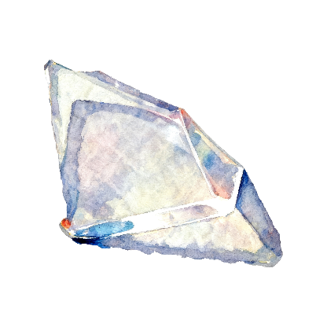


EnteroPlastivore
HOME
PROJECT
SAFETY
HUMAN PRACTICE
MODEL
TEAM
There are 325
microplastic particles in every liter of bottled water we drink.
*这里打算做一个从0开始累加的效果
后面的数字也是

Slide 6
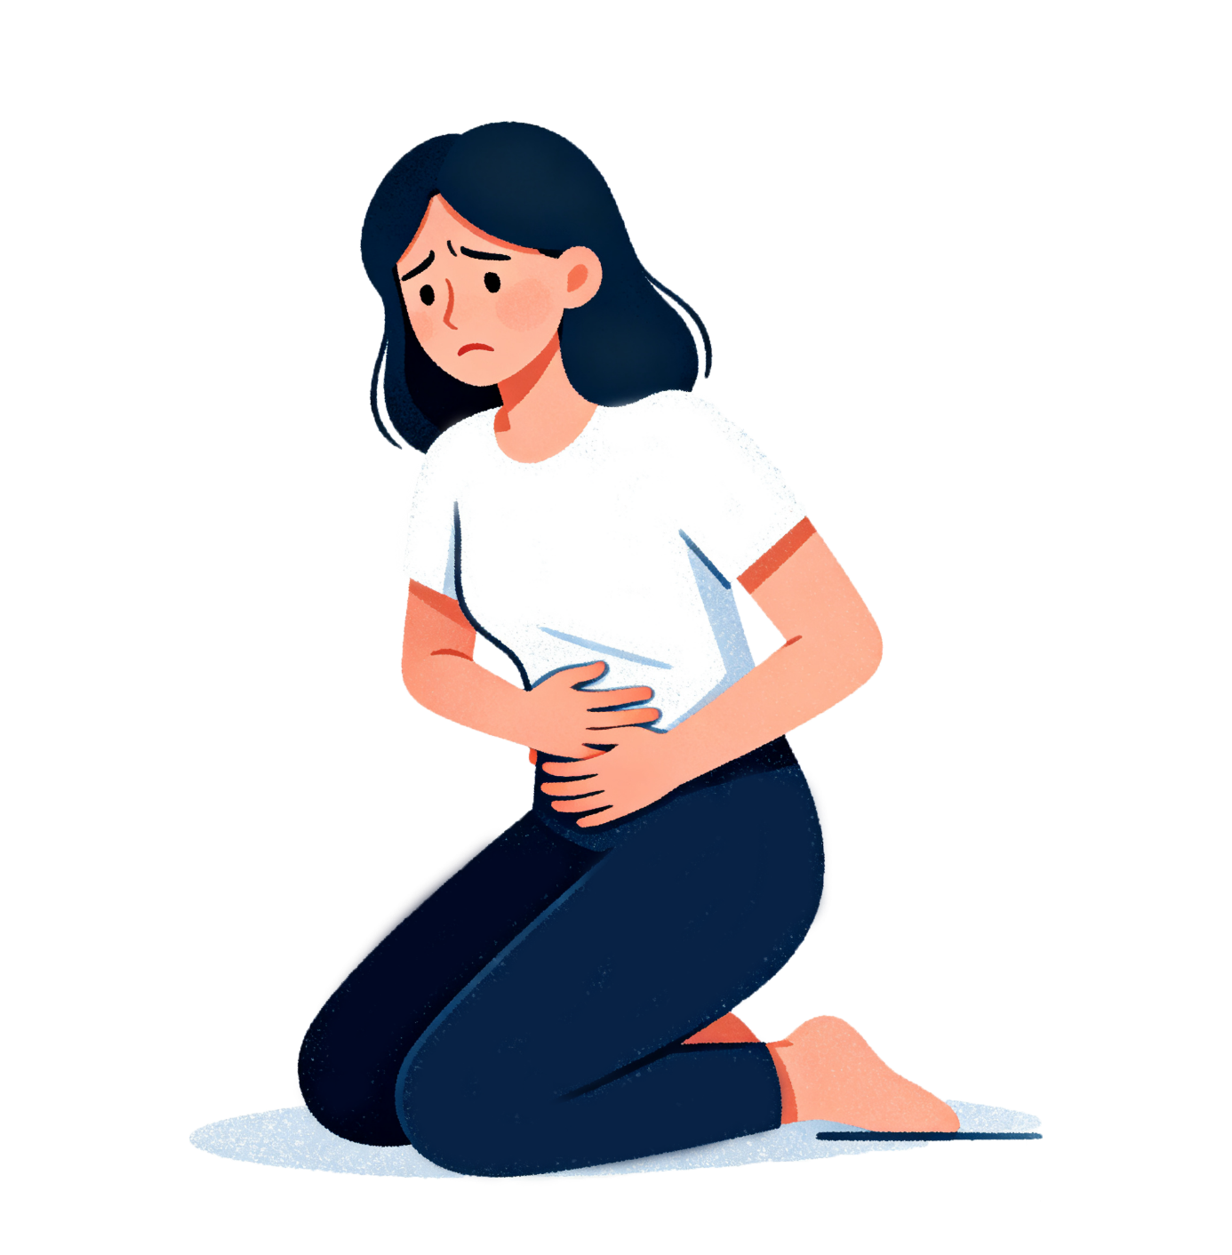
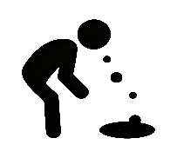

EnteroPlastivore
HOME
PROJECT
SAFETY
HUMAN PRACTICE
MODEL
TEAM
*如果可以的话 想要在这里加上一个 字体从左到右浮现的效果
It is shown that plastic pollution has caused about
million people to experience gastrointestinal symptoms such as bloating & diarrhea.
BLOATING
230
DIARRHEA

Slide 7
EnteroPlastivore
HOME
PROJECT
SAFETY
HUMAN PRACTICE
MODEL
TEAM
Fortunately, we modified the chassis bacteria and named it
"EnteroPlastivore"

Slide 8
EnteroPlastivore
HOME
PROJECT
SAFETY
HUMAN PRACTICE
MODEL
TEAM
Fortunately, we modified the chassis bacteria and named it
"EnteroPlastivore"

Slide 9
EnteroPlastivore
HOME
PROJECT
SAFETY
HUMAN PRACTICE
MODEL
TEAM
Fortunately, we modified the chassis bacteria and named it
"EnteroPlastivore"

Slide 10
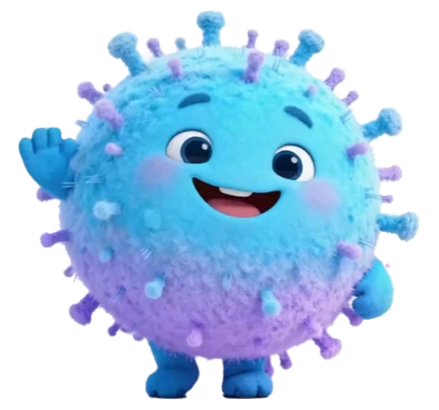
EnteroPlastivore
HOME
PROJECT
SAFETY
HUMAN PRACTICE
MODEL
TEAM
Fortunately, we modified the chassis bacteria and named it
"EnteroPlastivore"
*这里我做了一个webp动画,PPT上展示不出来，网页上可以透明底的放映

Slide 11
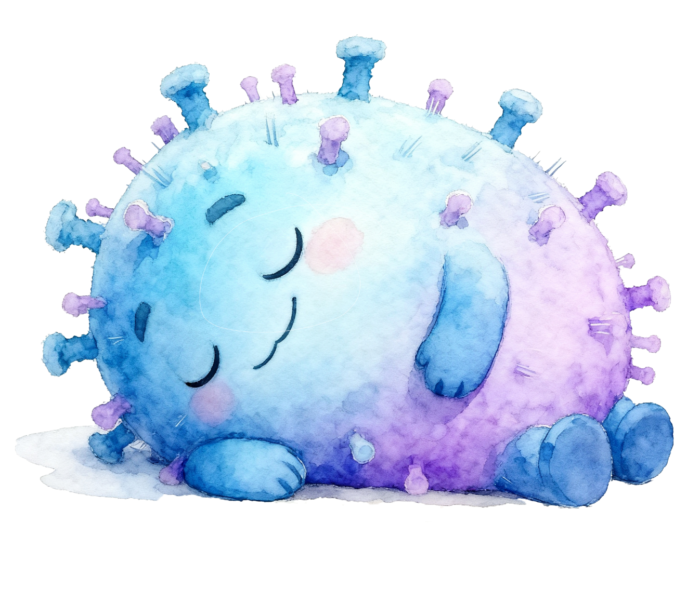
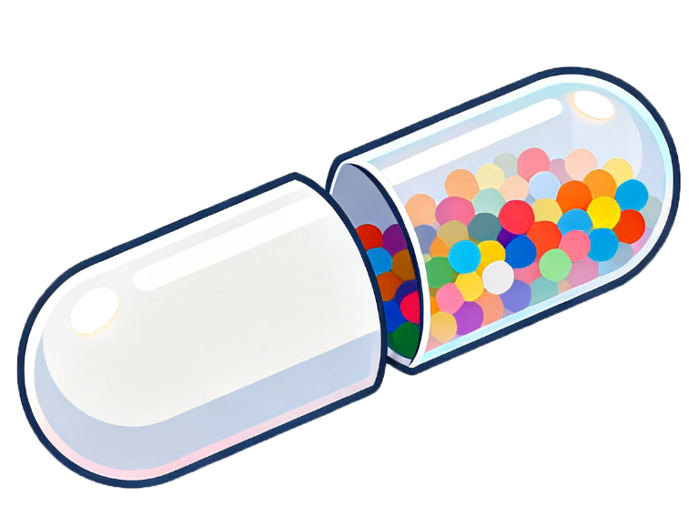
EnteroPlastivore
HOME
PROJECT
SAFETY
HUMAN PRACTICE
MODEL
TEAM
It will be encapsulated in a capsule to facilitate its entry into the body.
*这个胶囊也是想做个悬浮的效果

Slide 12
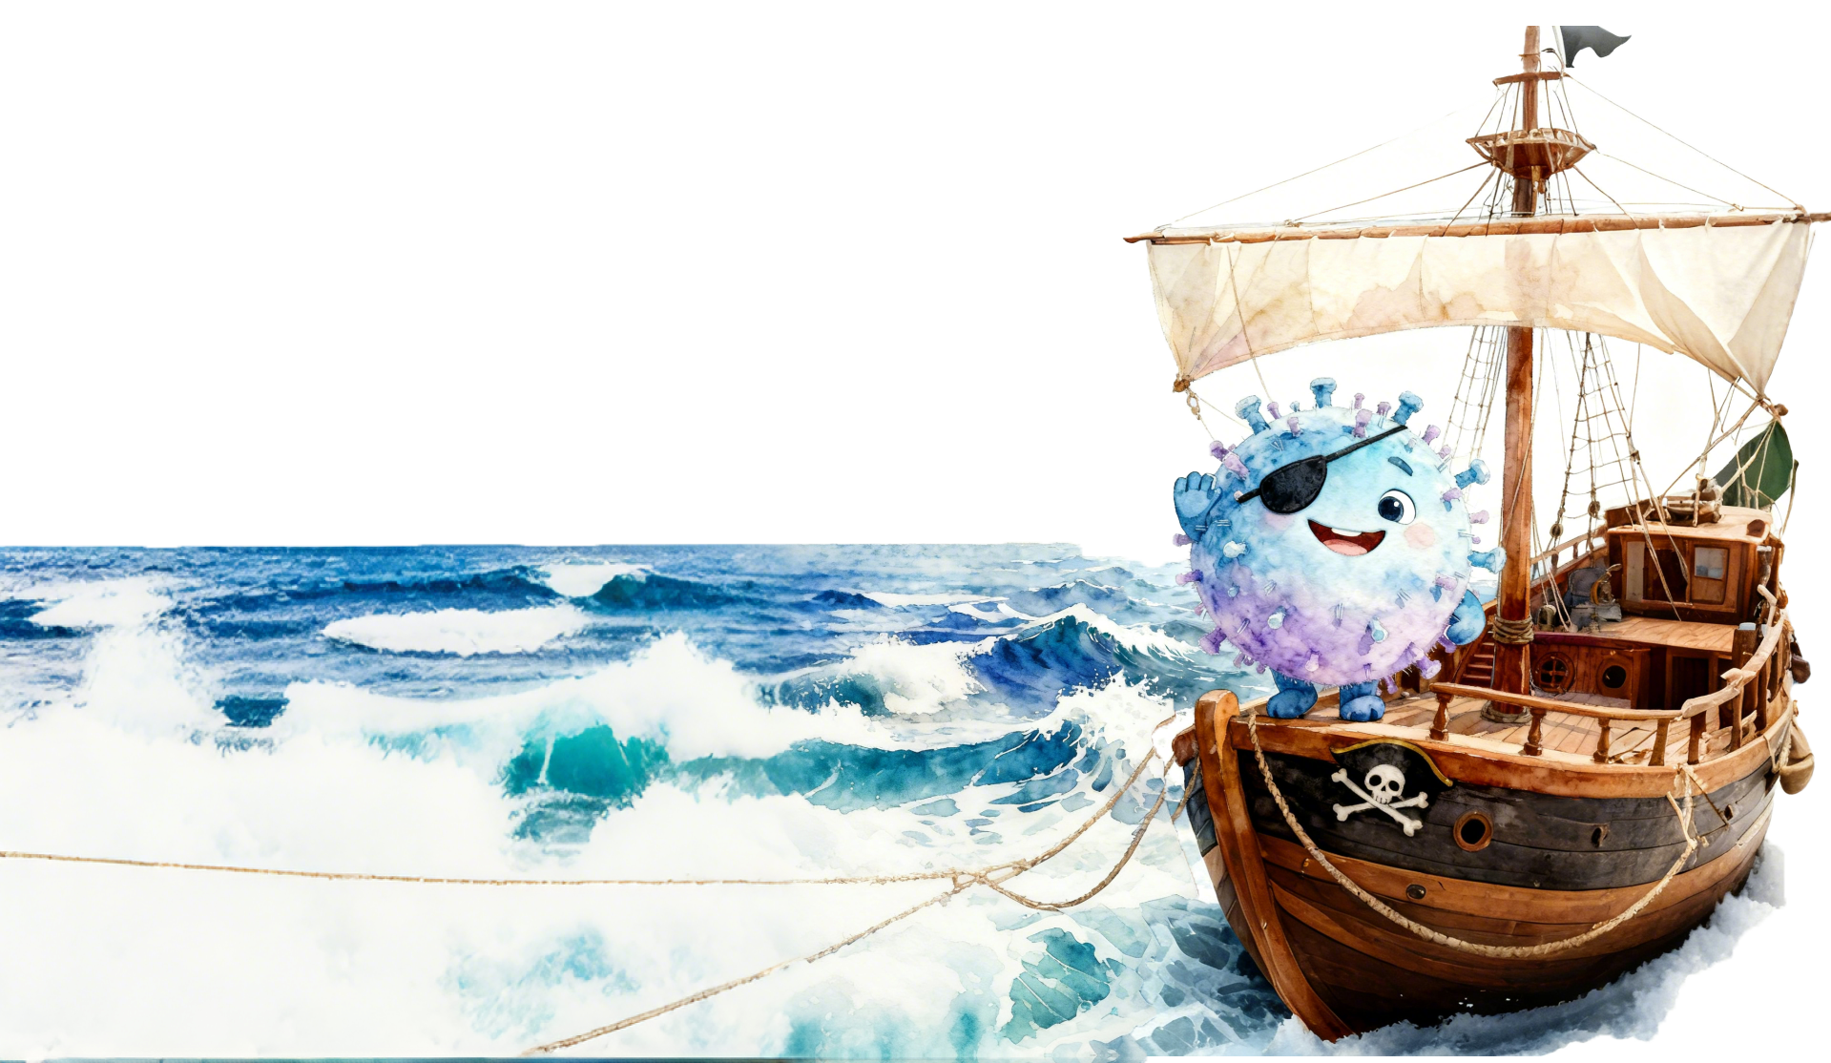
PXXXXXX
HOME
PROJECT
SAFETY
HUMAN PRACTICE
MODEL
TEAM
Once you swallow the capsule,
we will navigate through the tumultuous waves of the digestive system,
and an exciting adventure will begin!

Slide 13
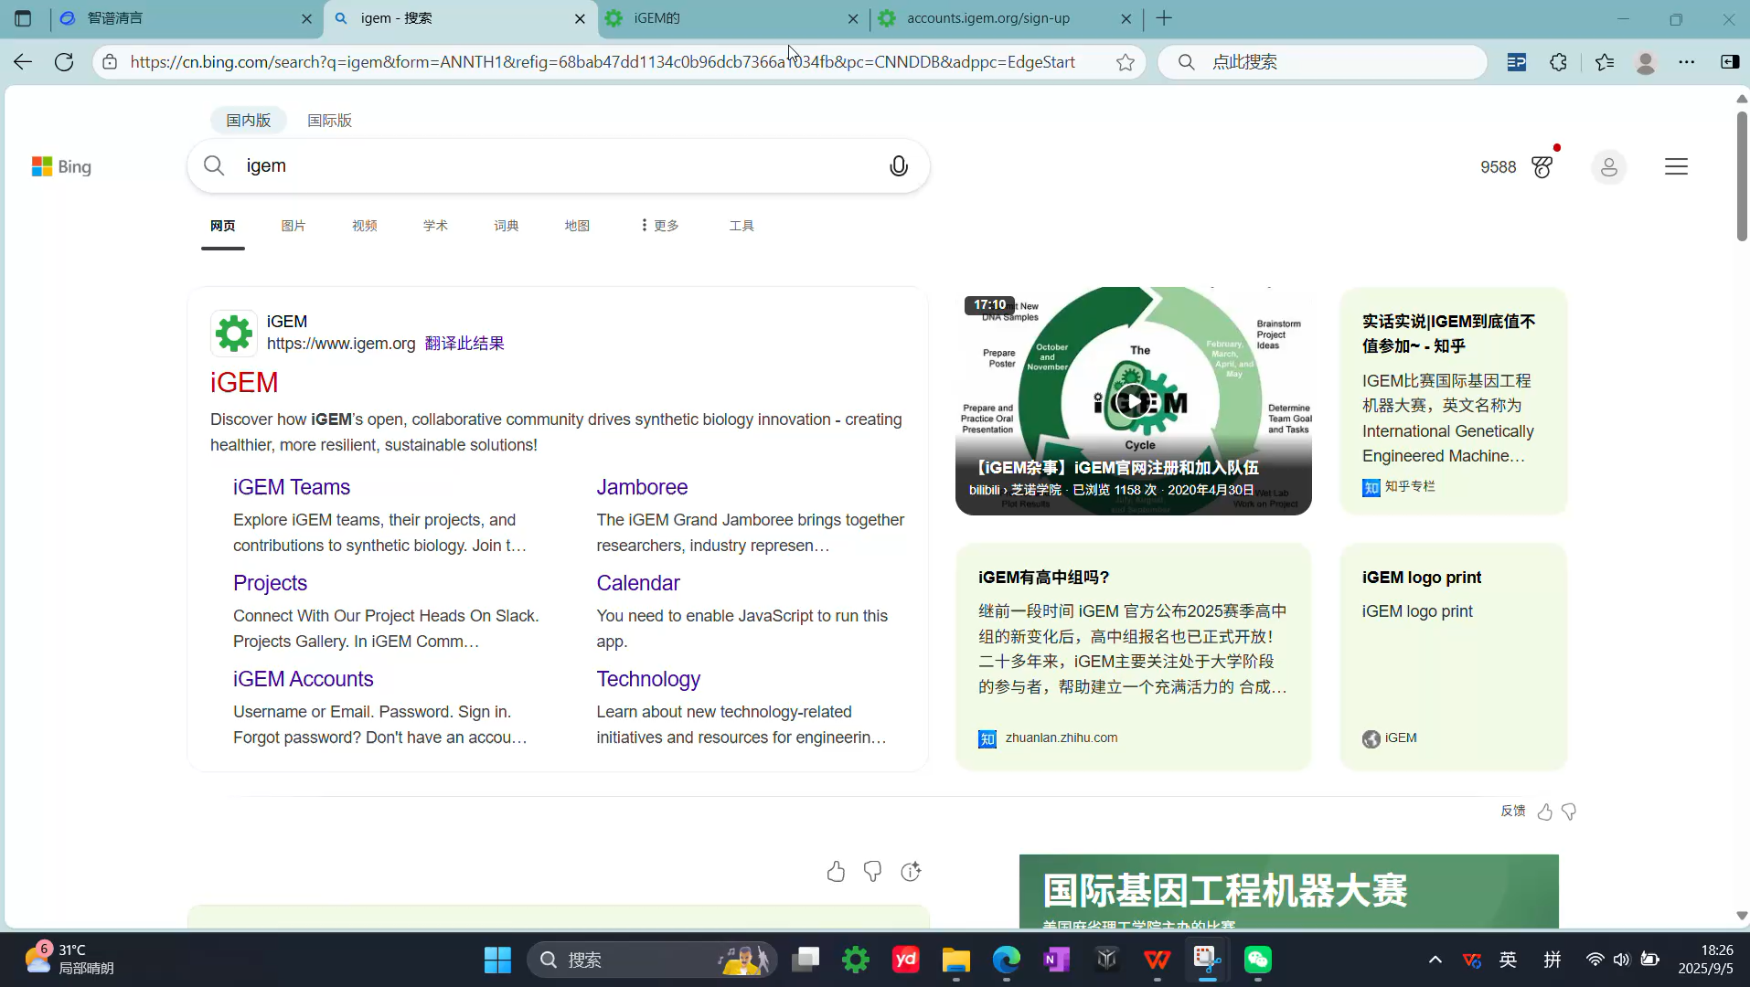
EnteroPlastivore
HOME
PROJECT
SAFETY
HUMAN PRACTICE
MODEL
TEAM
查看我们的presentation video here!
*这边最好旁边补充一下装饰

Slide 14
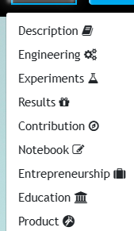
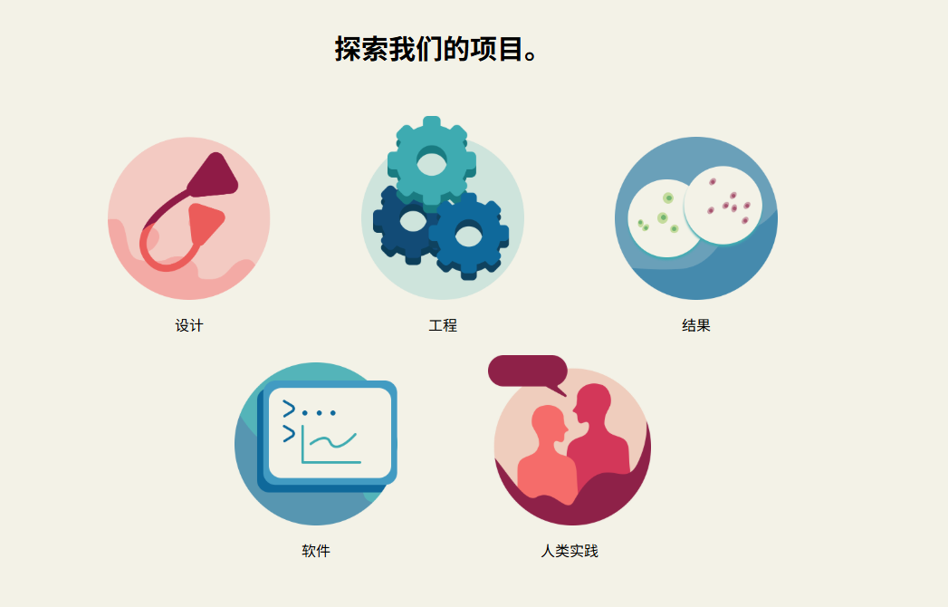
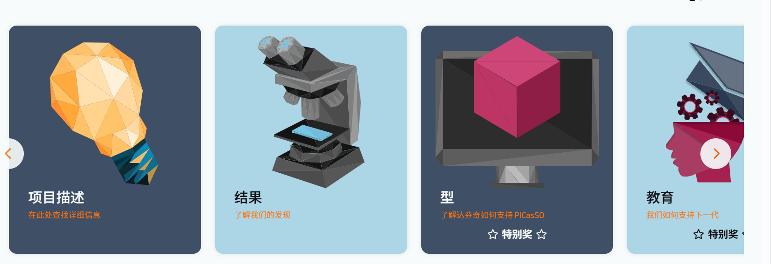
EnteroPlastivore
HOME
PROJECT
SAFETY
HUMAN PRACTICE
MODEL
TEAM
Explore our project.
*对应description engineering experiments HP product
等等 设计几个图标
*可做圆的 可做方的 随你

Slide 15
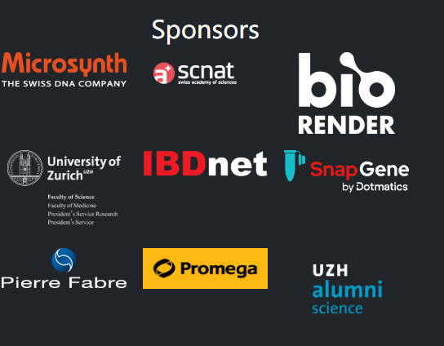
EnteroPlastivore
HOME
PROJECT
SAFETY
HUMAN PRACTICE
MODEL
TEAM
*这里是底边栏
Contact
*对应跳转链接
EnteroPlastivore
iGEM NMU_China
© 2022 - Content on this site is licensed under a Creative Commons Attribution 4.0 International license.
The repository uXXXXXXXXsed to create this website is available at gitlab.igem.org/2022/epfl. XXXXXXXXXX

Slide 16
EnteroPlastivore
HOME
PROJECT
SAFETY
HUMAN PRACTICE
MODEL
TEAM
*等候界面 不能webp的话就放LOGO好了
Loading...

Slide 17
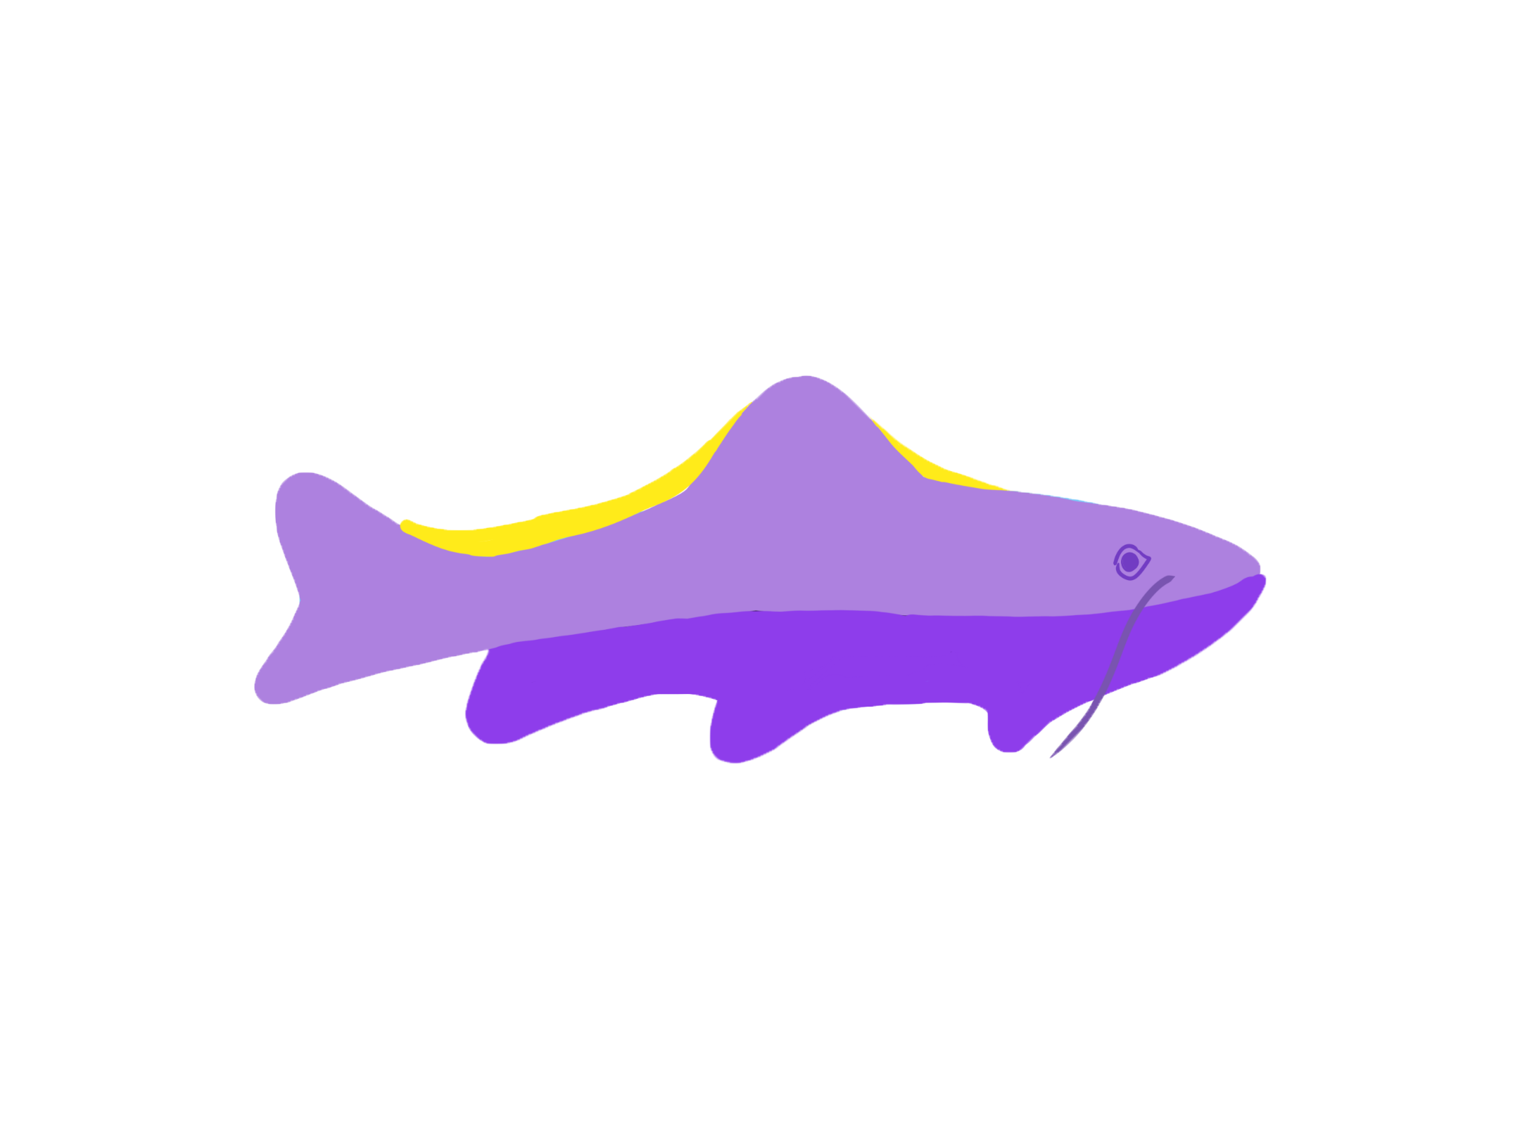
*这页是我用来放图标的 留着好了 无需在意

Slide 18
PXXXXXX
HOME
PROJECT
SAFETY
HUMAN PRACTICE
MODEL
TEAM

Slide 19
PXXXXXX
HOME
PROJECT
SAFETY
HUMAN PRACTICE
MODEL
TEAM
*这里用的平滑 本身是想做海浪汹涌的效果

Slide 20
EnteroPlastivore
HOME
PROJECT
SAFETY
HUMAN PRACTICE
MODEL
TEAM
Fortunately, we modified the chassis bacteria and named it

Slide 21
EnteroPlastivore
HOME
PROJECT
SAFETY
HUMAN PRACTICE
MODEL
TEAM

Slide 22
EnteroPlastivore
HOME
PROJECT
SAFETY
HUMAN PRACTICE
MODEL
TEAM

Slide 23
EnteroPlastivore
HOME
PROJECT
SAFETY
HUMAN PRACTICE
MODEL
TEAM

